Slide 1
Welcome to the risky decision making game! Depending on how you make decisions in this game you can win some money that adds to your bonus pay.
In this game you will be asked to make decision between two options.

Slide 2
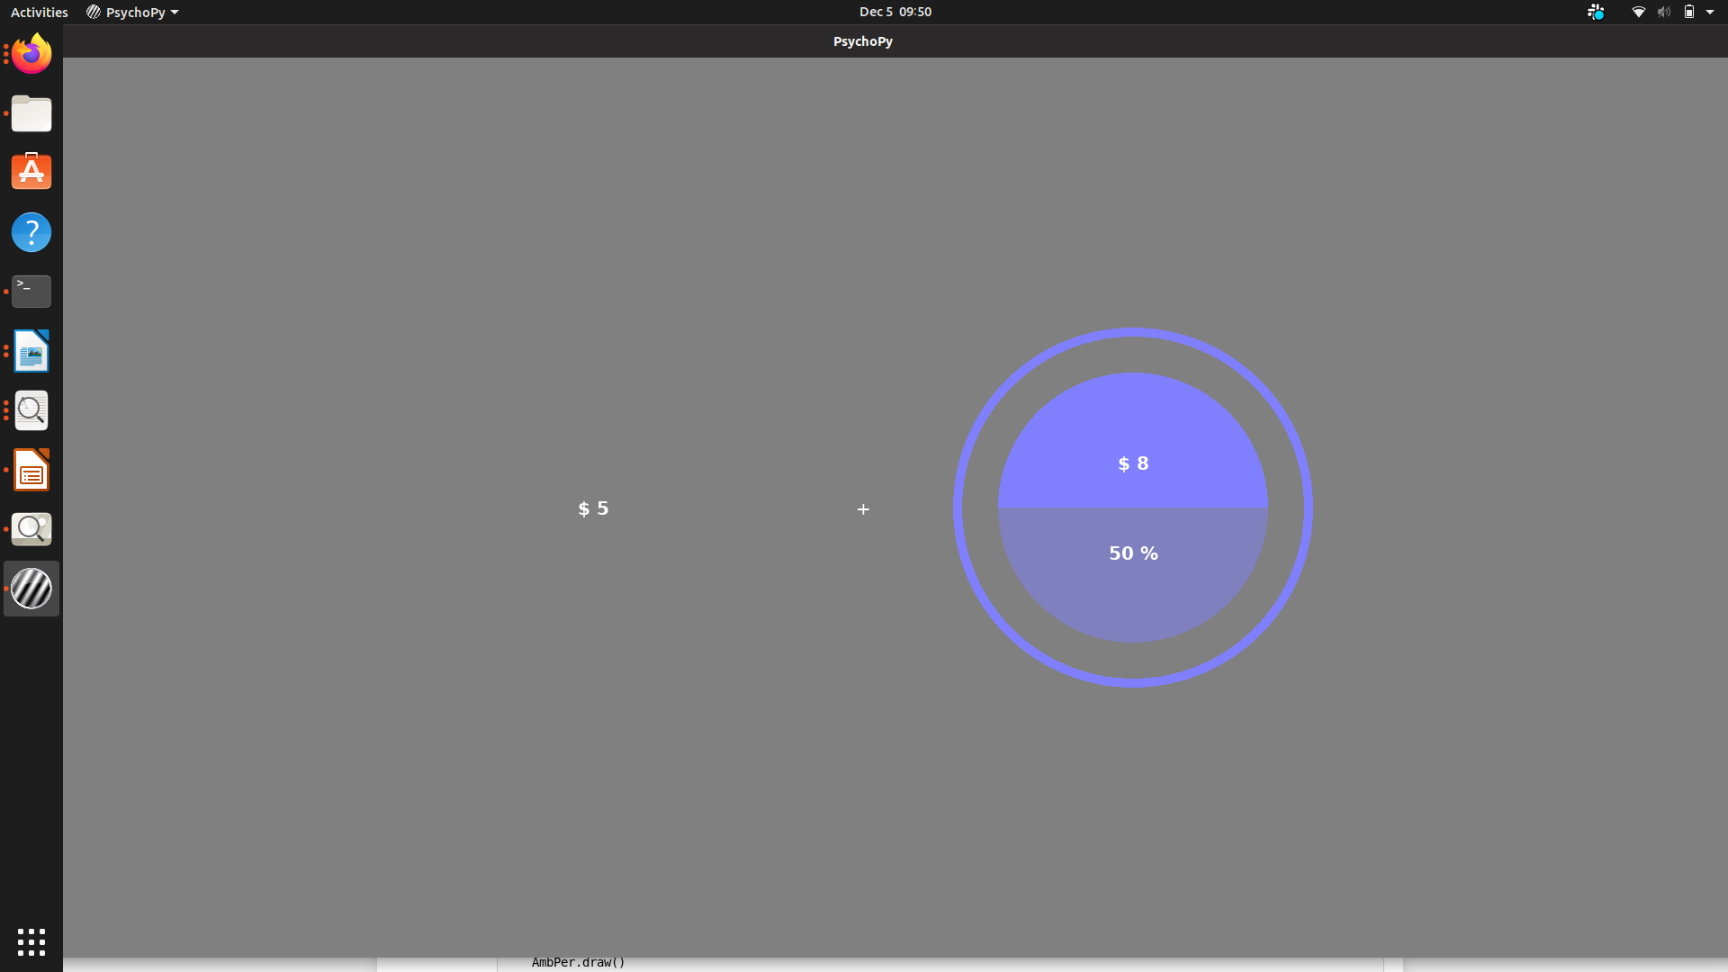
In Part 1 you will make a decision between a change of winning a large amount of money or a smaller “safe” amount of money. For example a 50% chance of winning $8 or a sure $5.

Slide 3
The Blue Pie chart represents a lottery.
The $8 written at the top is the prize you can win.
The area of the solid color & the “%” show your chance of winning the prize.

Slide 4
In this example you need to choose between a sure $5 and a 50% chance at winning $8.
To choose the option on the left, press ‘F’
To choose the option on the right, press ‘J’

Slide 5
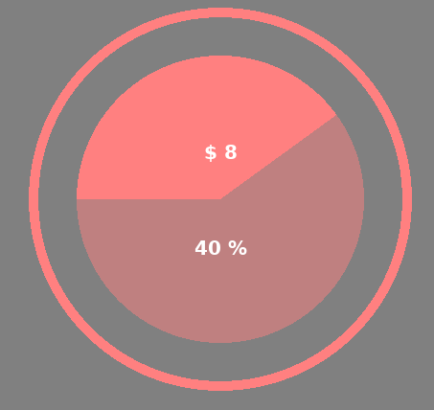
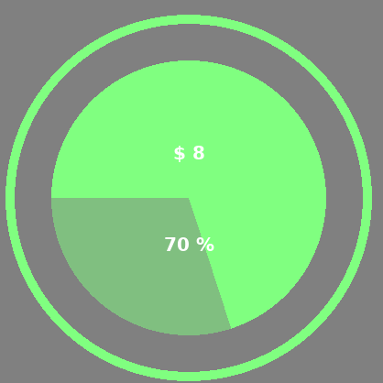
During Part 1 you will make many similar decisions with 3 different colored lotteries Red, Green, & Blue.
Take notice of how favorable each color lottery tends to be while you make your decisions.

Slide 6
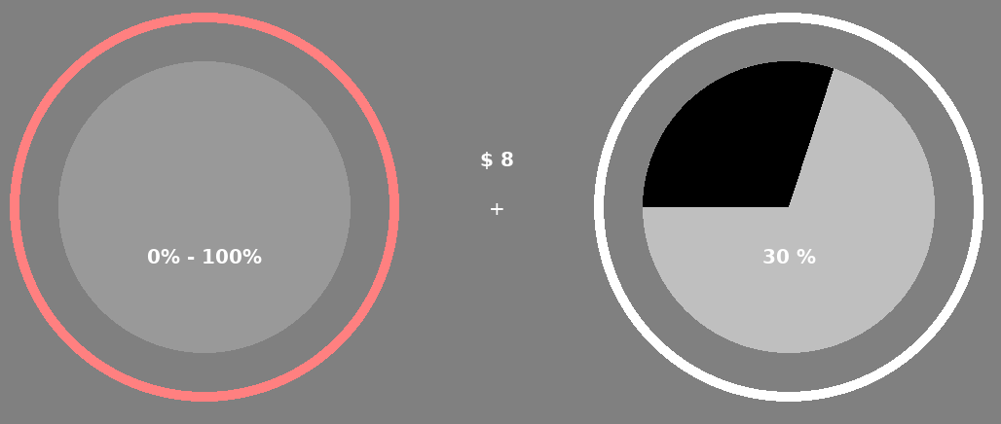
In Part 2 you choose between different lotteries.
One is a normal lottery & the other is an ambiguous RED lottery where the chance of winning is not fully known.

Slide 7
Here you’re offered a lottery with a 30% chance of winning & one with between 0% & 100%

Slide 8
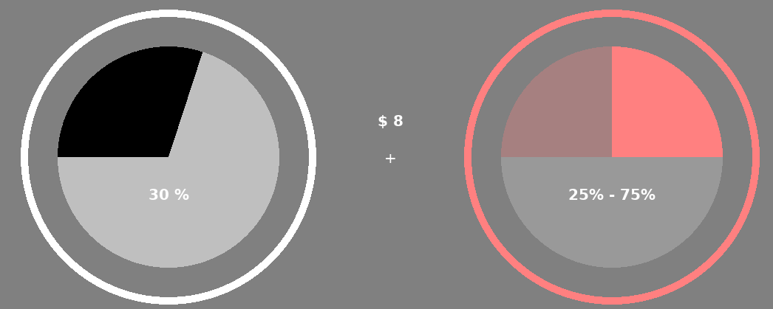
Some ambiguous lotteries will only cover part. Now you know your chance of winning with the ambiguous lottery is between 25% - 75%.
However you can also use your experience from Part 1 to help

Slide 9
Ambiguous lottery is really a randomly chosen lottery of the same color from Part 1.
In this example if all RED lotteries in Part 1 had a 60% chance of winning you know the ambiguous lottery is better than the 40% lottery.

Slide 10
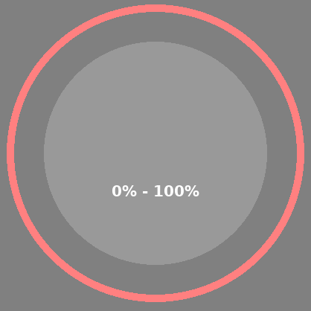
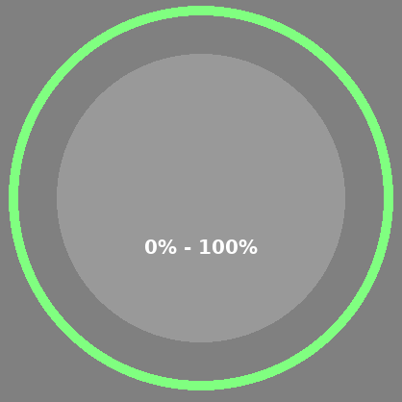
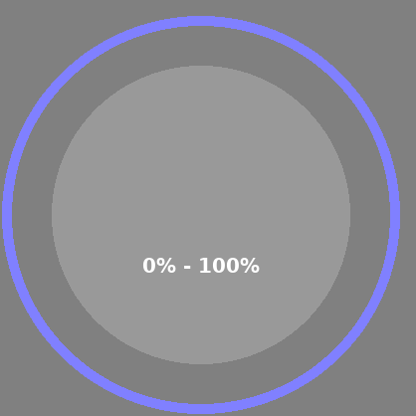
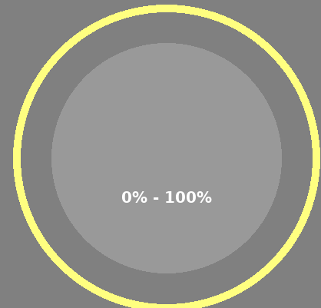
You will make decisions about ambiguous lotteries that are RED, GREEN, BLUE, & YELLOW.
You can use what you learned in Part 1 to help you make decisions about RED, GREEN, & BLUE lotteries.
However for the YELLOW lotteries you will need to “go with your gut”

Slide 11
There are no right or wrong answers. The best strategy is to pick the option you want the most.
To pick the option on the Left press “F”
To pick the option on the Right press “J”
Remember to pay attention to how frequently favorable lotteries are presented in Part 1.
Do you have any Questions before you start?
When you’re ready hit space.

Slide 12
Please let the experimenter know you have finished Part 1

Slide 13
We’re about to start Part 2
Remember now you will be picking between
To pick the option on the Left press “F”
To pick the option on the Right press “J”
Remember you can use the color of the ambiguous lottery as well as how much is “covered” to determine how valuable it is.
When you’re ready hit space

